Slide 1



303105151 - Computational Thinking for Structured Design-2
Miss. Miral Maradiya
Assistant Professor
AIDS

Slide 2


CHAPTER-6
Searching and Sorting

Slide 3
Contents
Sorting
Selection sort, BubbleSort, Insertion sort
2.Searching
Linear and Binary Searching Techniques

Slide 4
6.1 Selection Sort
Selection sort is a simple sorting algorithm.
The list is divided into two parts,
The sorted part at the left end and
The unsorted part at the right end.
Initially, the sorted part is empty and the unsorted part is the entire list.
The smallest element is selected from the unsorted array and swapped with the leftmost element, and that element becomes a part of the sorted array.
This process continues moving unsorted array boundary by one element to the right.
This algorithm is not suitable for large data sets as its average and worst case complexities are of Ο(n2), where n is the number of items.

Slide 5
SELECTION_SORT ALGORITHM
selectionSort(array, size)
for i from 0 to size - 1 do
set i as the index of the current minimum
for j from i + 1 to size - 1 do
if array[j] < array[current minimum]
set j as the new current minimum index
if current minimum is not i
swap array[i] with array[current minimum]
end selectionSort

Slide 6
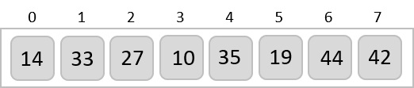
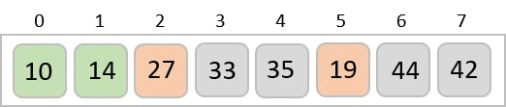
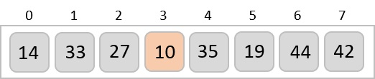
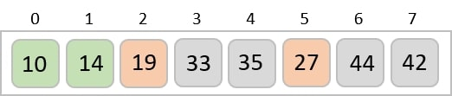
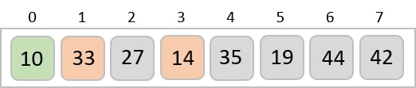
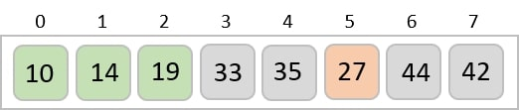
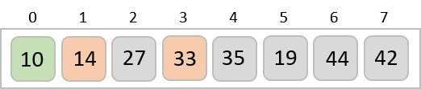
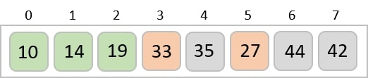
SELECTION_SORT Example

Slide 7
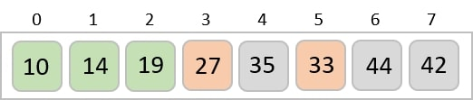
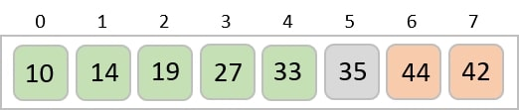
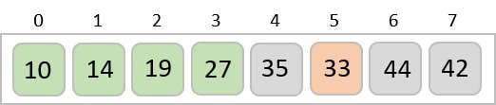
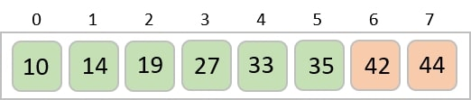
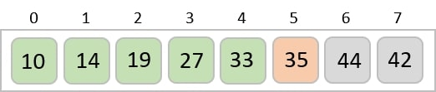
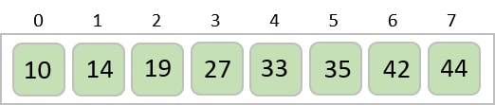
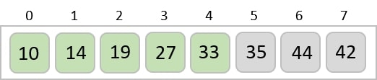
SELECTION_SORT Example

Slide 8
SELECTION_SORT Code
void selectionSort(int array[], int size) {
for (int i = 0; i< size - 1; i++) {
int min = i;
for (int j= i + 1; j < size; j++) {
// Select the minimum element in each loop.
if (array[j] < array[min])
min = j;
}
// put min at the correct position
swap(&array[min], &array[i]);
}
}
// Selection sort in C
#include <stdio.h>
// function to swap the the position of two elements
void swap(int *a, int *b) {
int temp = *a;
*a = *b;
*b = temp;
}

Slide 9
SELECTION_SORT
// function to print an array
void printArray(int array[], int size) {
for (int i = 0; i < size; ++i) {
printf("%d ", array[i]);
}
printf("\n");
}
// driver code
int main() {
int data[] = {20, 12, 10, 15, 2};
int size = sizeof(data) / sizeof(data[0]);
selectionSort(data, size);
printf("Sorted array in Acsending Order:\n");
printArray(data, size);
Return 0;
}

Slide 10
6.2 Bubble Sort
Unlike selection sort, instead of finding the smallest record and performing the interchange, two records are interchanged immediately upon discovering that they are out of order
During the first pass R1 and R2 are compared and interchanged in case of our of order, this process is repeated for records R2 and R3, and so on.
This method will cause records with small key to move “bubble up”,
After the first pass, the record with largest key will be in the nth position.
On each successive pass, the records with the next largest key will be placed in position n-1,
n-2 ….., 2 respectively
This approached required at most n–1 passes, The complexity of bubble sort is O(n2)

Slide 11
BUBBLE_SORT Algorithm
bubbleSort(array)
for i <- 1 to sizeOfArray - 1
for j <- 1 to sizeOfArray - 1 - i
if leftElement > rightElement
swap leftElement and rightElement
end bubbleSort

Slide 12
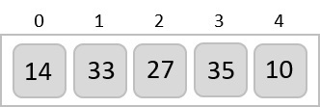
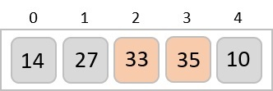
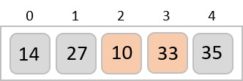
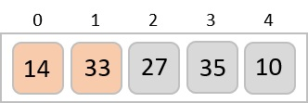
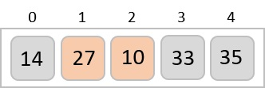
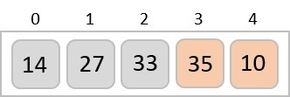
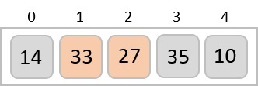
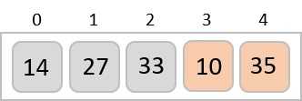
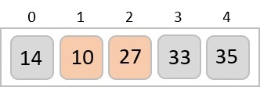

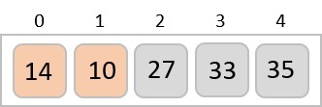

BUBBLE_SORT

Slide 13
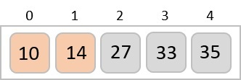
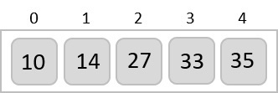
BUBBLE_SORT

Slide 14
BUBBLE_SORT Code
if (array[j] > array[j + 1]) {
// swapping occurs if elements
// are not in the intended order
int temp = array[j];
array[j] = array[j + 1];
array[j + 1] = temp;
}
}
}
}
// Bubble sort in C
#include <stdio.h>
// perform the bubble sort
void bubbleSort(int array[], int size) {
// loop to access each array element
for (int i = 0; i < size - 1; i++) {
// loop to compare array elements
for (int j = 0; j < size – 1-i; j++) {
// compare two adjacent elements

Slide 15
BUBBLE_SORT Code
int main() {
int data[] = {-2, 45, 0, 11, -9};
// find the array's length
int size = sizeof(data) / sizeof(data[0]);
bubbleSort(data, size);
printf("Sorted Array in Ascending Order:\n");
printArray(data, size);
Return 0;
}
// print array
void printArray(int array[], int size) {
for (int i = 0; i < size; ++i) {
printf("%d ", array[i]);
}
printf("\n");
}

Slide 16
6.3 Insertion Sort
In insertion sort, every iteration moves an element from unsorted portion to sorted portion until all the elements are sorted in the list.
Steps for Insertion Sort
Assume that first element in the list is in sorted portion of the list and remaining all elements are in unsorted portion.
Select first element from the unsorted list and insert that element into the sorted list in order specified.
Repeat the above process until all the elements from the unsorted list are moved into the sorted list.
This algorithm is not suitable for large data sets

Slide 17
Complexity of the Insertion Sort Algorithm
To sort a unsorted list with 'n' number of elements we need to make (1+2+3+......+n-1) = (n (n-1))/2 number of comparisons in the worst case.
If the list already sorted, then it requires 'n' number of comparisons.
Worst Case : Θ(n2)
Best Case : Ω(n)
Average Case : Θ(n2)

Slide 18
Insertion Sort Algorithm
insertionSort(array)
mark first element as sorted
for each unsorted element X
'extract' the element X
for j <- lastSortedIndex down to 0
if current element j > X
move sorted element to the right by 1
break loop and insert X here
end insertionSort

Slide 19
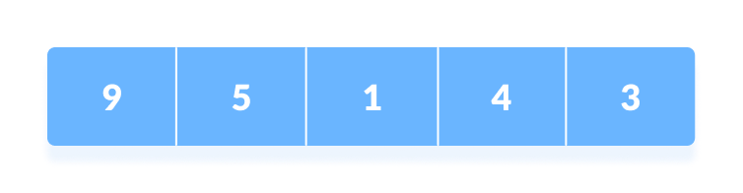
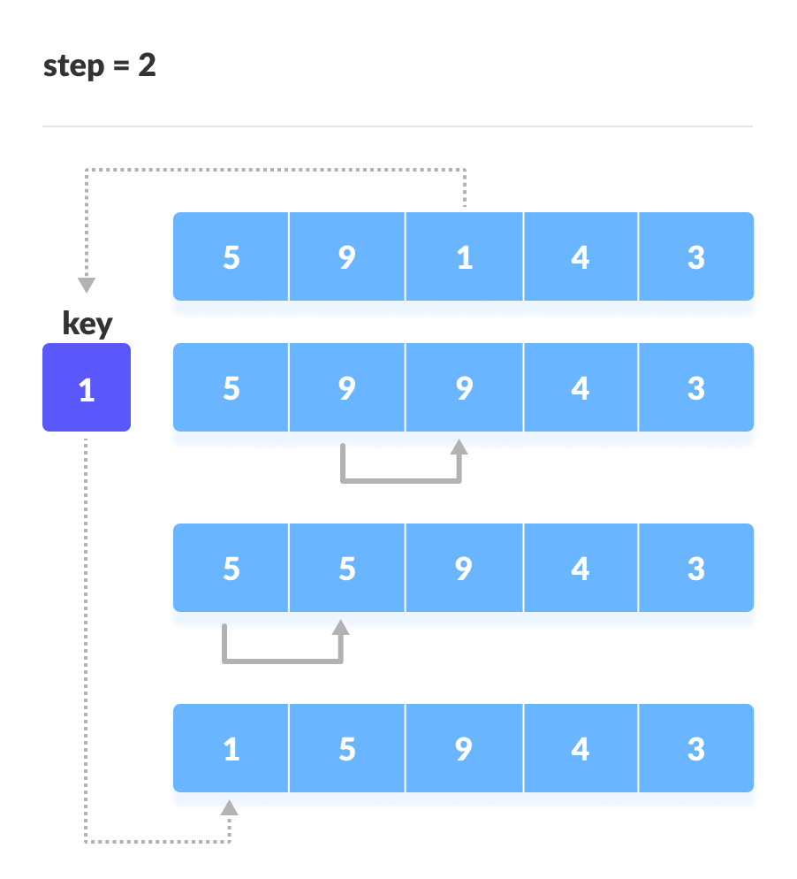
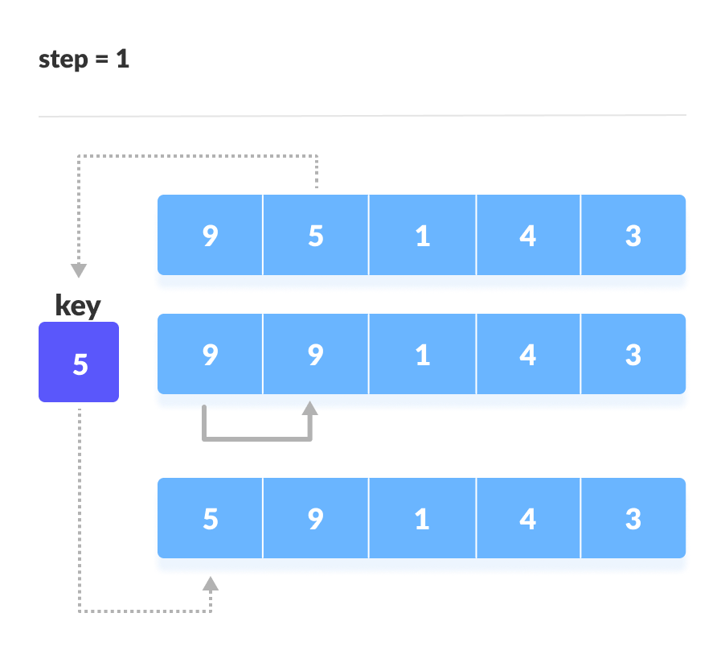
Insertion Sort

Slide 20

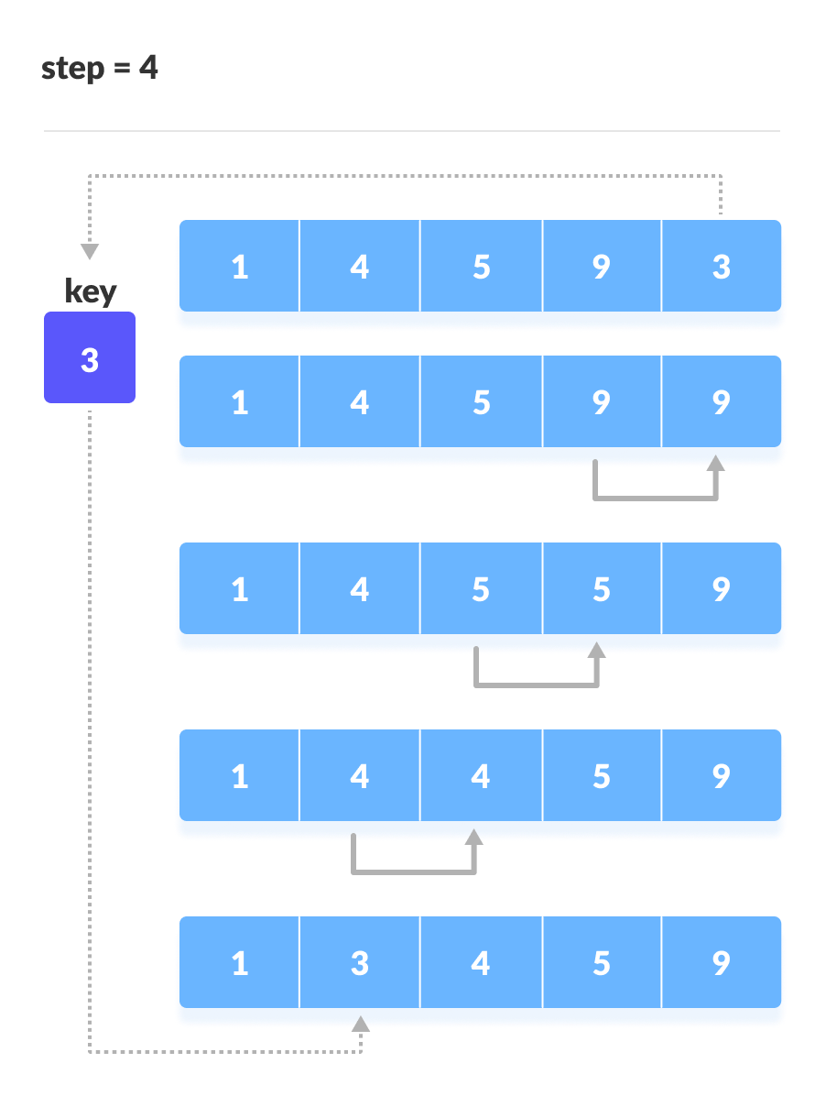

Slide 21
Insertion Sort
// Insertion sort in C
#include <stdio.h>
// Function to print an array
void printArray(int array[], int size) {
for (int i = 0; i < size; i++) {
printf("%d ", array[i]);
}
printf("\n");
}
void insertionSort(int array[], int size) {
for (int i = 1; i < size; i++) {
int temp = array[i];
int j = i- 1;
// Compare key with each element on the left of it until an element smaller than
// it is found.
while (j >=0 && temp < array[j]) {
array[j + 1] = array[j];
j--;
}
array[j + 1] = temp;
}
}

Slide 22
Insertion Sort
// Driver code
int main() {
int data[] = {9, 5, 1, 4, 3};
int size = sizeof(data) / sizeof(data[0]);
insertionSort(data, size);
printf("Sorted array in ascending order:\n");
printArray(data, size);
Return 0;
}

Slide 23
6.4 Linear/Sequential Search
In computer science, linear search or sequential search is a method for finding a particular value in a list that consists of checking every one of its elements, one at a time and in sequence, until the desired one is found.
Linear search is the simplest search algorithm.
It is a special case of brute-force search.
Its worst case cost is proportional to the number of elements in the list.

Slide 24
Sequential Search – Algorithm
# Input: Array A, integer key
# Output: first index of key in A
# or -1 if not found
Algorithm: Linear_Search
for i = 0 to last index of A:
if A[i] equals key:
return i
return -1

Slide 25
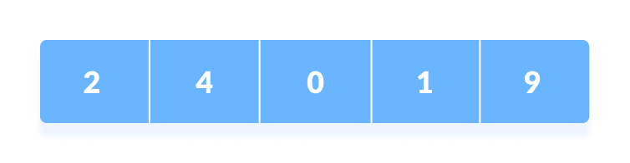
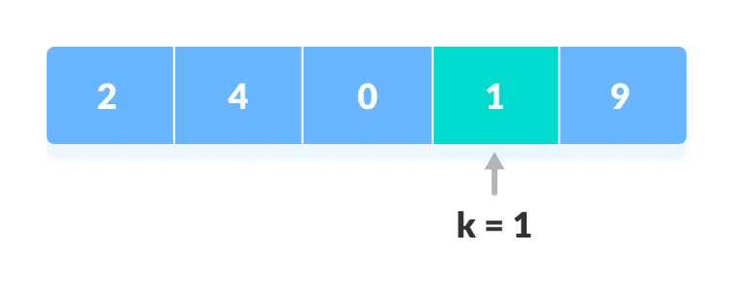
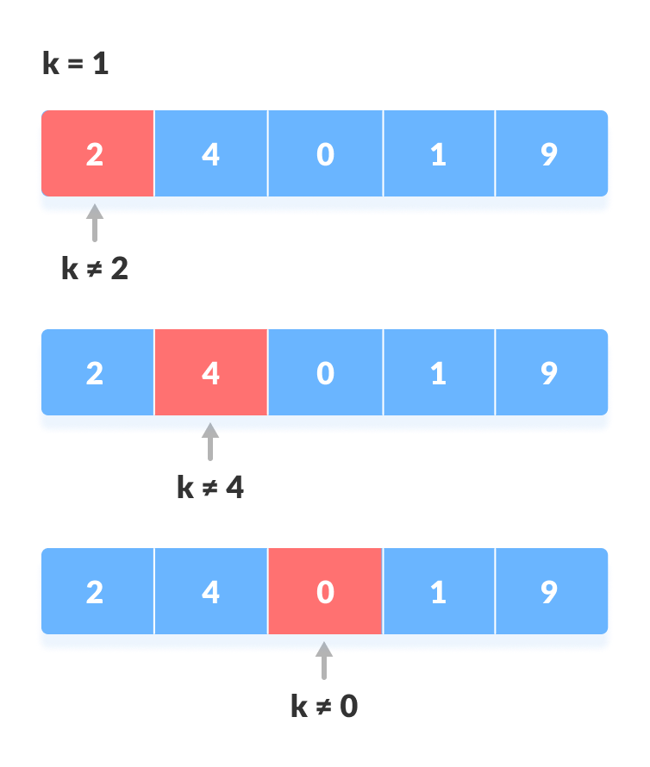
Sequential Search – with k=1

Slide 26
Sequential Search – Code
int main() {
int array[] = {2, 4, 0, 1, 9};
int x = 1;
int n = sizeof(array) / sizeof(array[0]);
int result = search(array, n, x);
(result == -1) ? printf("Element not found") : printf("Element found at index: %d", result);
return 0;
}
// Linear Search in C
#include <stdio.h>
int search(int array[], int n, int x) {
// Going through array sequencially
for (int i = 0; i < n; i++)
if (array[i] == x)
return i;
return -1;}

Slide 27
6.5 Binary Search
If we have an array that is sorted, we can use a much more efficient algorithm called a Binary Search.
In binary search each time we divide array into two equal half and compare middle element with search element.
Searching Logic
If middle element is equal to search element then we got that element and return that index
if middle element is less than search element we look right part of array
if middle element is greater than search element we look left part of array.

Slide 28
Binary Search - Algorithm
do until the pointers low and high meet each other.
mid = (low + high)/2
if (x == arr[mid])
return mid
else if (x > arr[mid]) // x is on the right side
low = mid + 1
else // x is on the left side
high = mid - 1

Slide 29
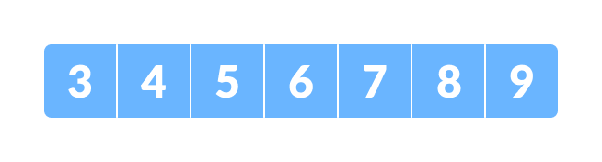
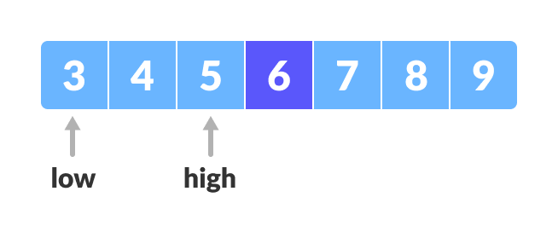
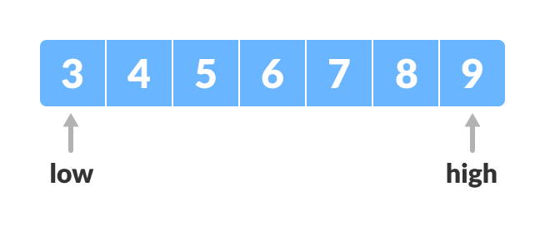
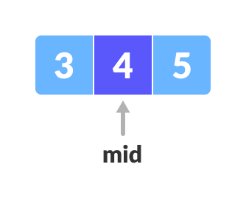
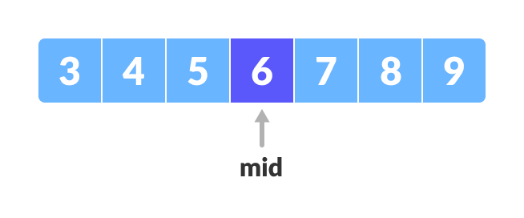
Binary Search – for x=4

Slide 30
Binary Search - Code
int main(void) {
int array[] = {3, 4, 5, 6, 7, 8, 9};
int n = sizeof(array) / sizeof(array[0]);
int x = 4;
int result = binarySearch(array, x, 0, n - 1);
if (result == -1)
printf("Not found");
else
printf("Element is found at index %d", result);
return 0;
}
// Binary Search in C
#include <stdio.h>
int binarySearch(int array[], int x, int low, int high) {
// Repeat until the pointers low and high meet each other
while (low <= high) {
int mid = low + (high - low) / 2;
if (x == array[mid])
return mid;
if (x > array[mid])
low = mid + 1;
else
high = mid - 1;
}
return -1;
}

Slide 31


